Slide 1


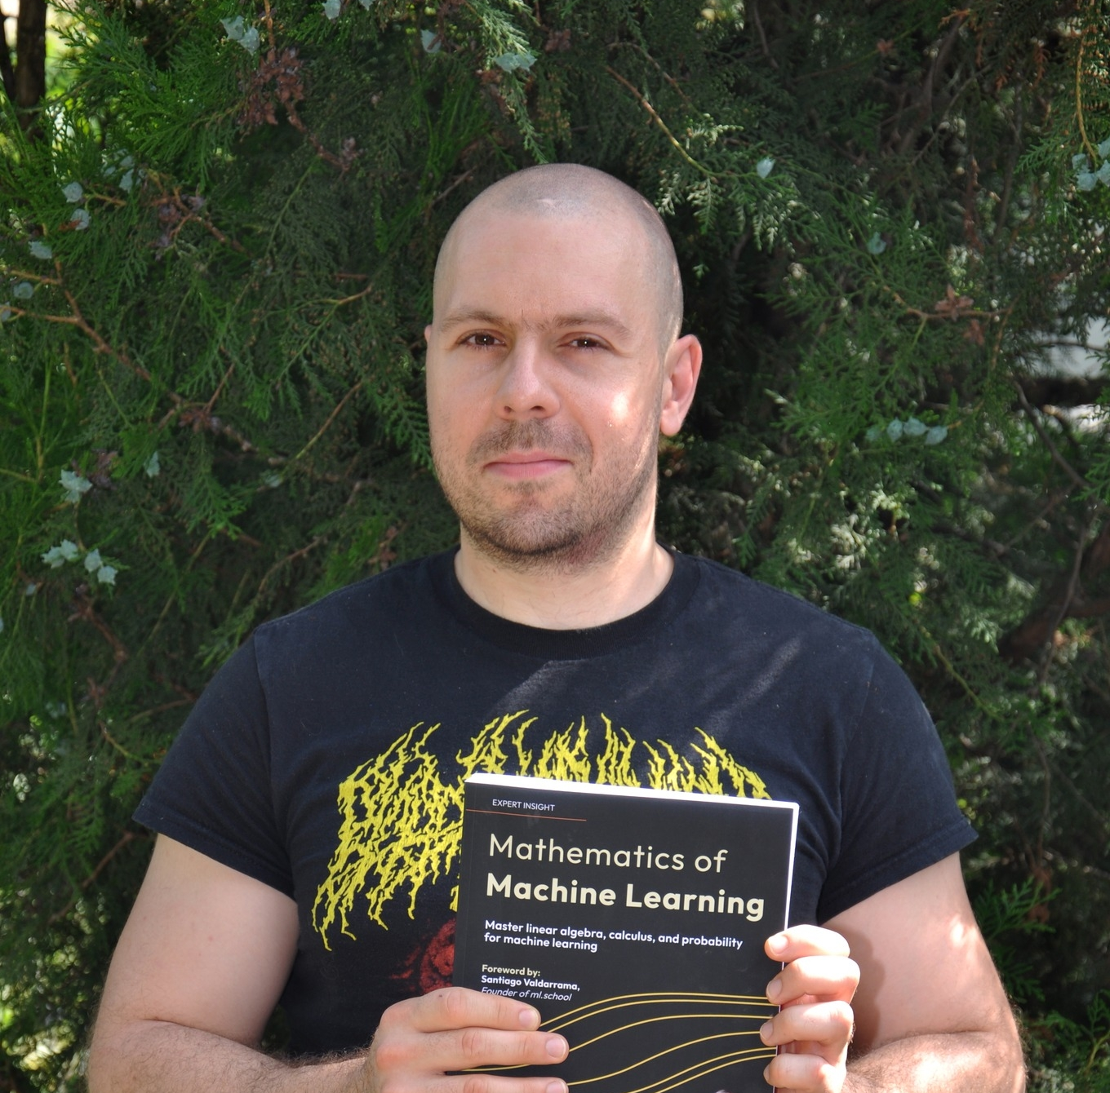
Starting Now
Not Just a Black Box:
Understanding ML Through Mathematics
Session Description (2-3 high-Q takeaways)
Tivadar Danka
Educator

Slide 2

Not Just a Black Box:
Understanding ML Through Mathematics

Slide 3
About Tivadar Danka
Did his PhD in Mathematics, working in machine learning ever since
Focused on building an education platform centered on mathematics and machine learning
Wrote the book titled “Mathematics of Machine Learning”
Tivadar Danka
Educator

Slide 4
Why study math as a machine learning engineer?

Slide 5
Why study math as a machine learning engineer?
The multiple ways
to machine learning:
Theory
Practice
Domain expertise
>
Pg: 1

Slide 6

Why study math as a machine learning engineer?
The map
of your
skills:
>
Pg: 1

Slide 7
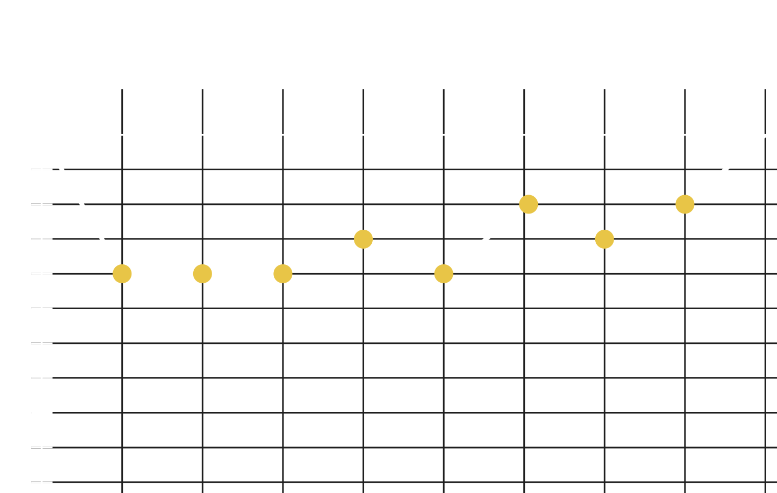
Why study math as a machine learning engineer?
The map
of your
skills:
generalist
approach
>
Pg: 1

Slide 8
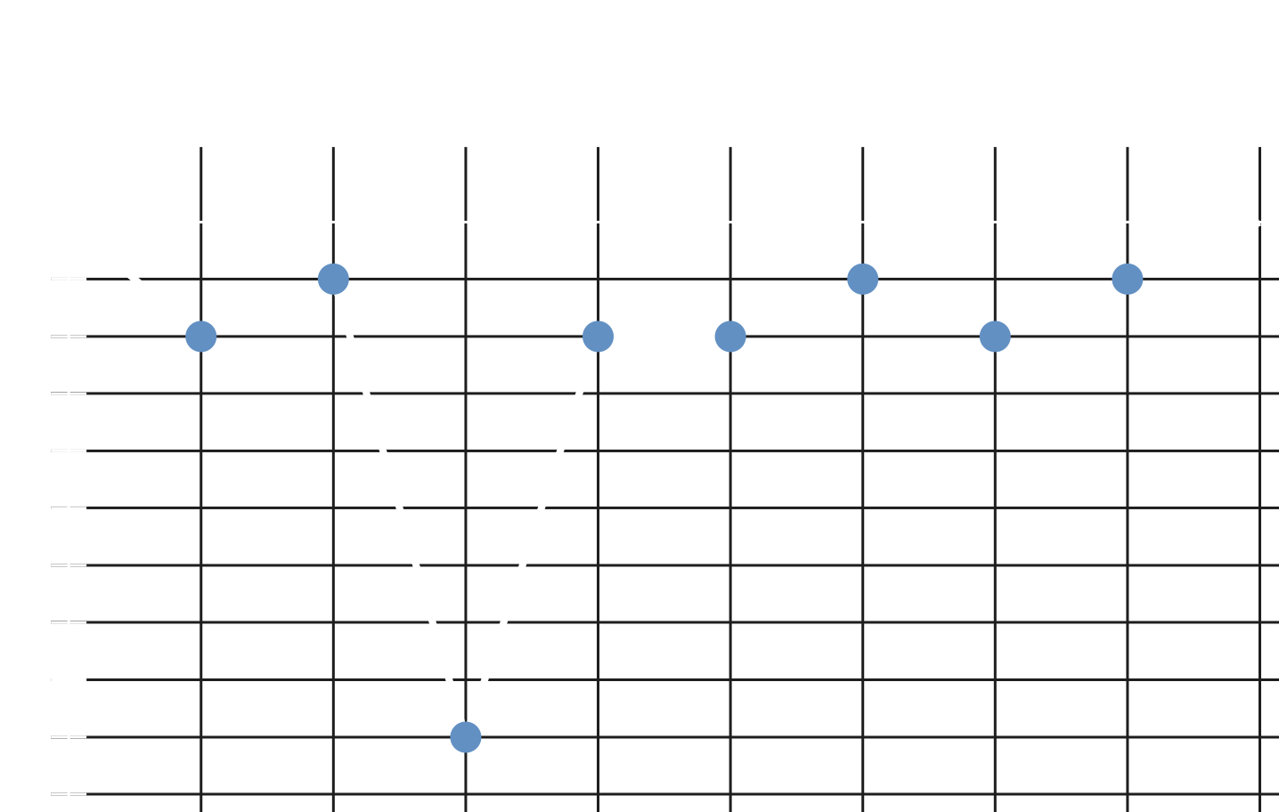
Why study math as a machine learning engineer?
The map
of your
skills:
specialist
approach
>
Pg: 1

Slide 9
Why study math as a machine learning engineer?
The skills you have depend
on where you are from.
The skills you need depend
on where you are going.
You always need some math.
>
Pg: 1

Slide 10
What kind of math
do you need?

Slide 11
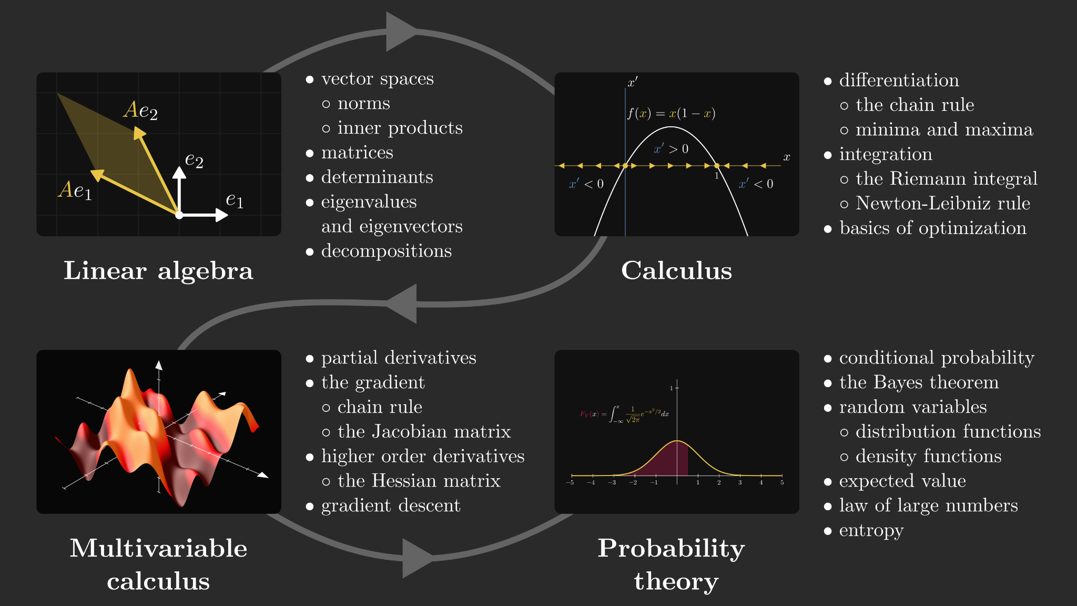
What kind of math do you need?
>
Pg: 1

Slide 12
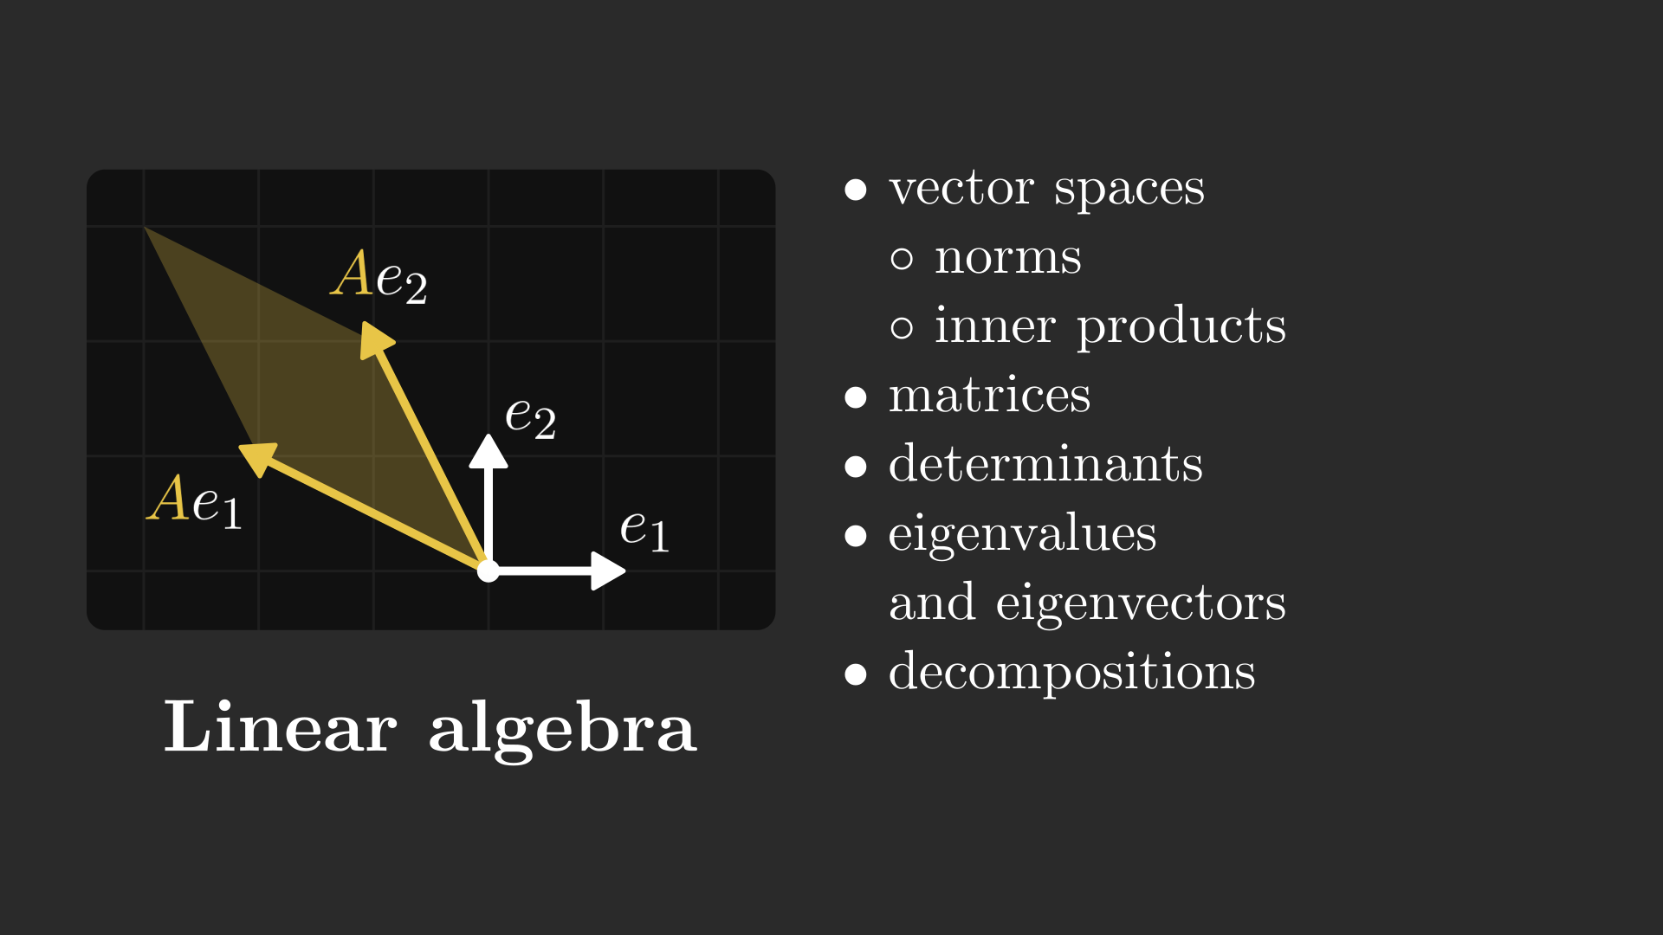
What kind of math do you need?
>
Pg: 1

Slide 13
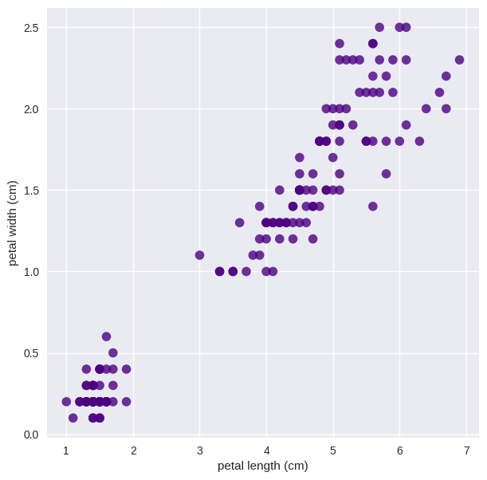
What kind of math do you need?
>
Pg: 1

Slide 14
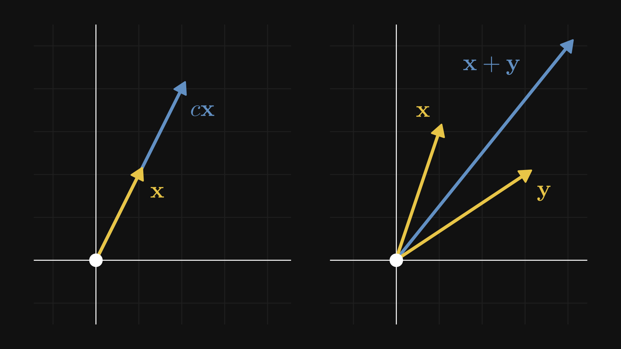
Linear algebra
>
Pg: 1

Slide 15
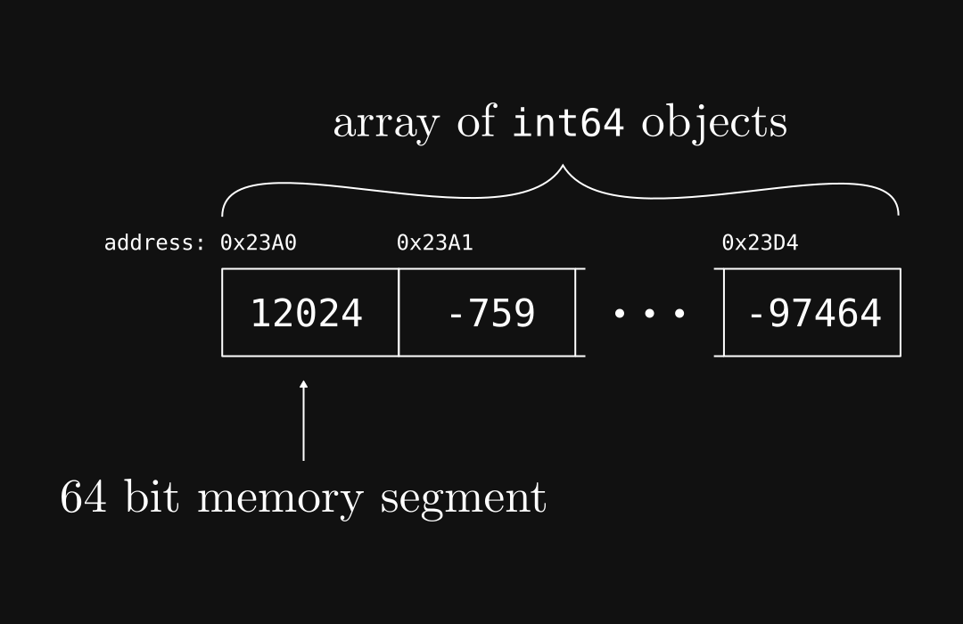
Linear algebra
>
Pg: 1

Slide 16
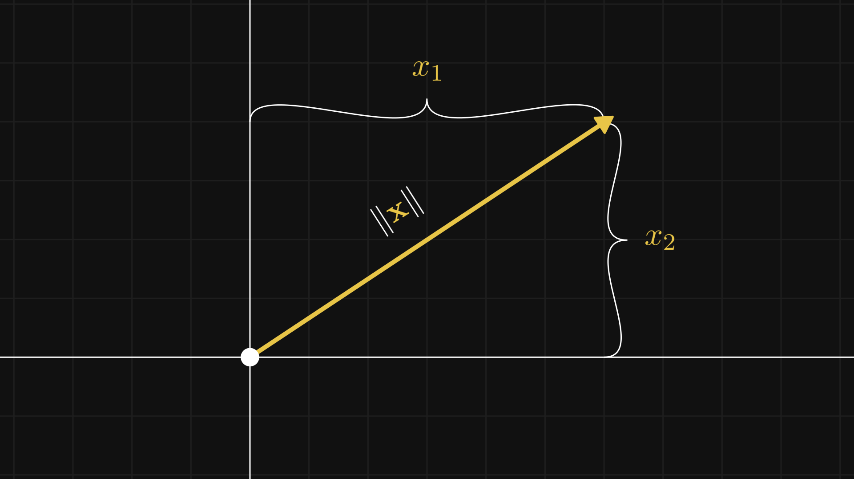
Linear algebra
>
Pg: 1

Slide 17
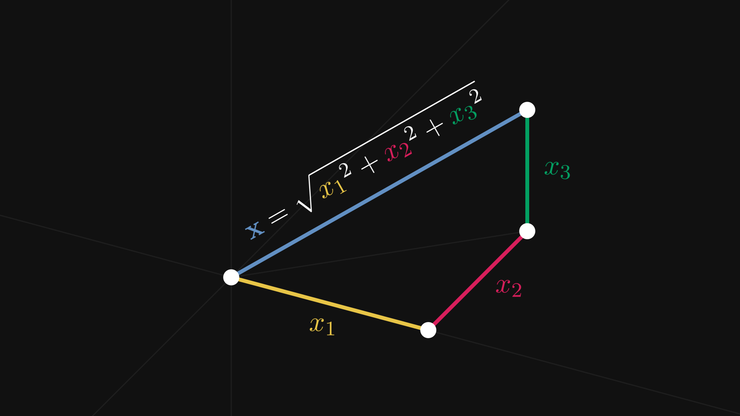
Linear algebra
>
Pg: 1

Slide 18
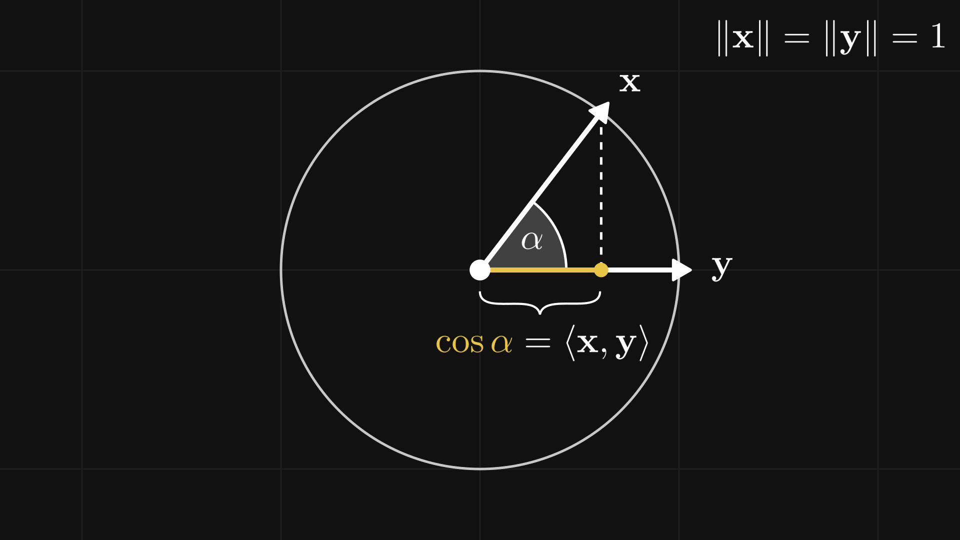
Linear algebra
>
Pg: 1

Slide 19
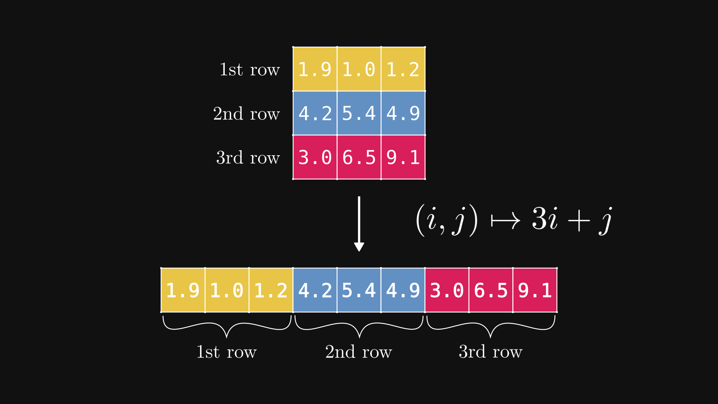
Linear algebra
>
Pg: 1

Slide 20
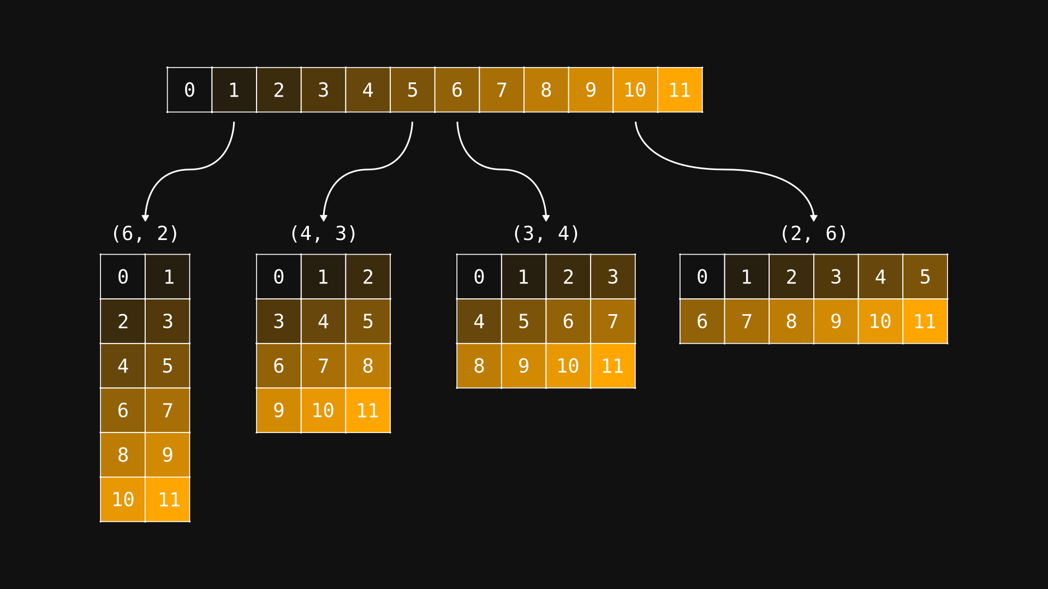
Linear algebra
>
Pg: 1

Slide 21
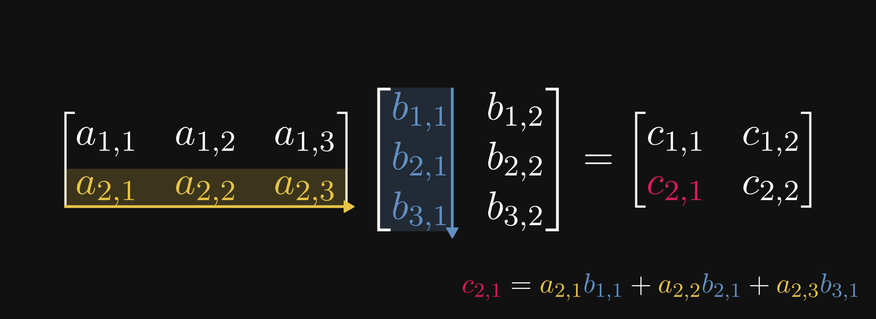
Linear algebra
>
Pg: 1

Slide 22
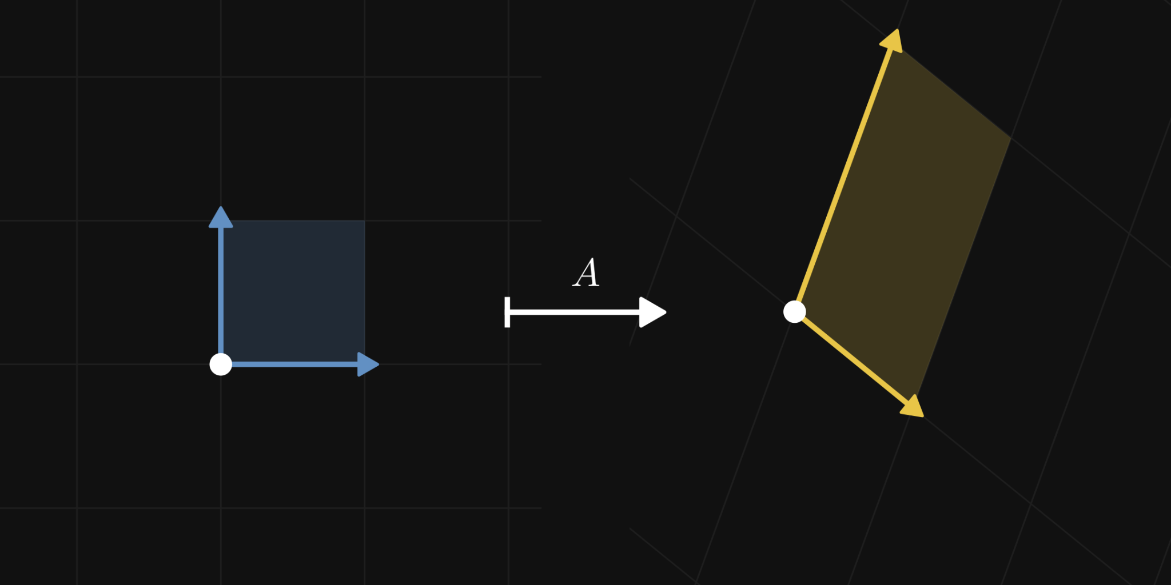
Linear algebra
>
Pg: 1

Slide 23
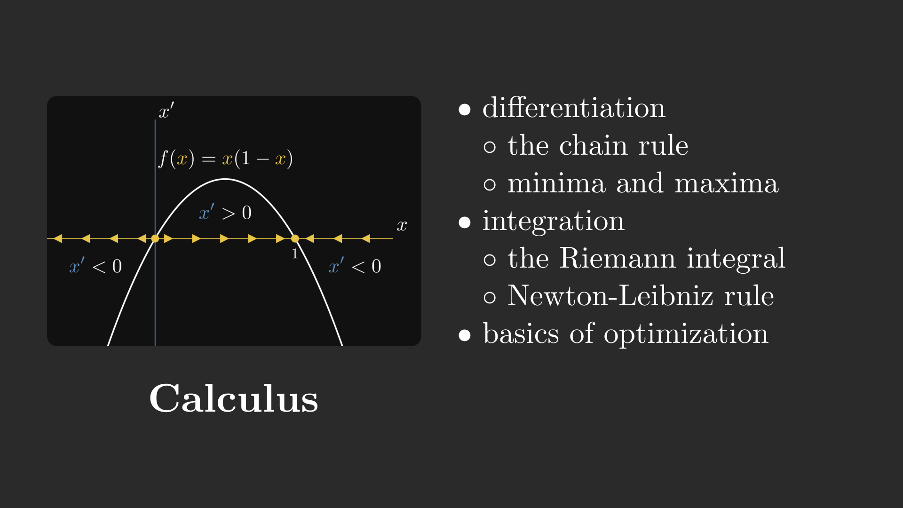
What kind of math do you need?
>
Pg: 1

Slide 24
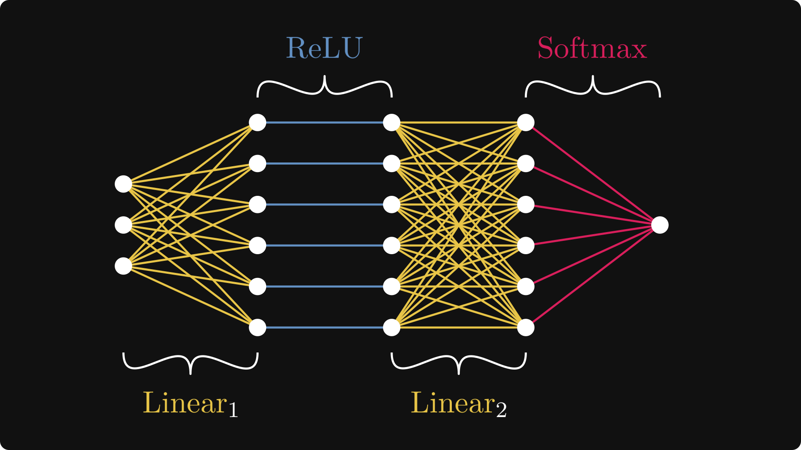
What kind of math do you need?
>
Pg: 1

Slide 25
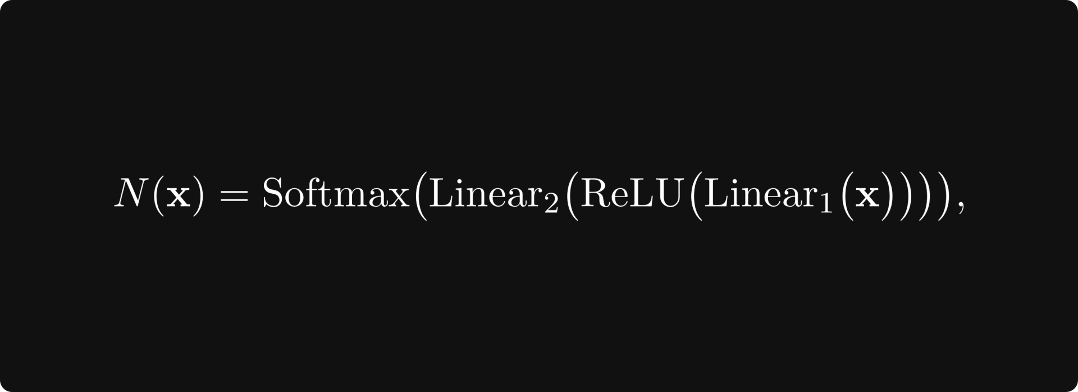
What kind of math do you need?
>
Pg: 1

Slide 26
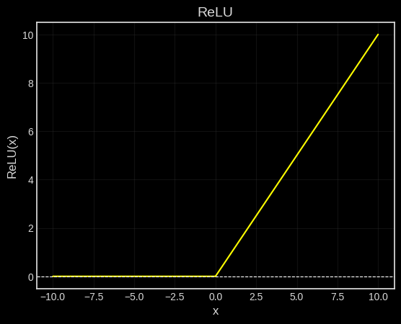
Calculus
>
Pg: 1

Slide 27
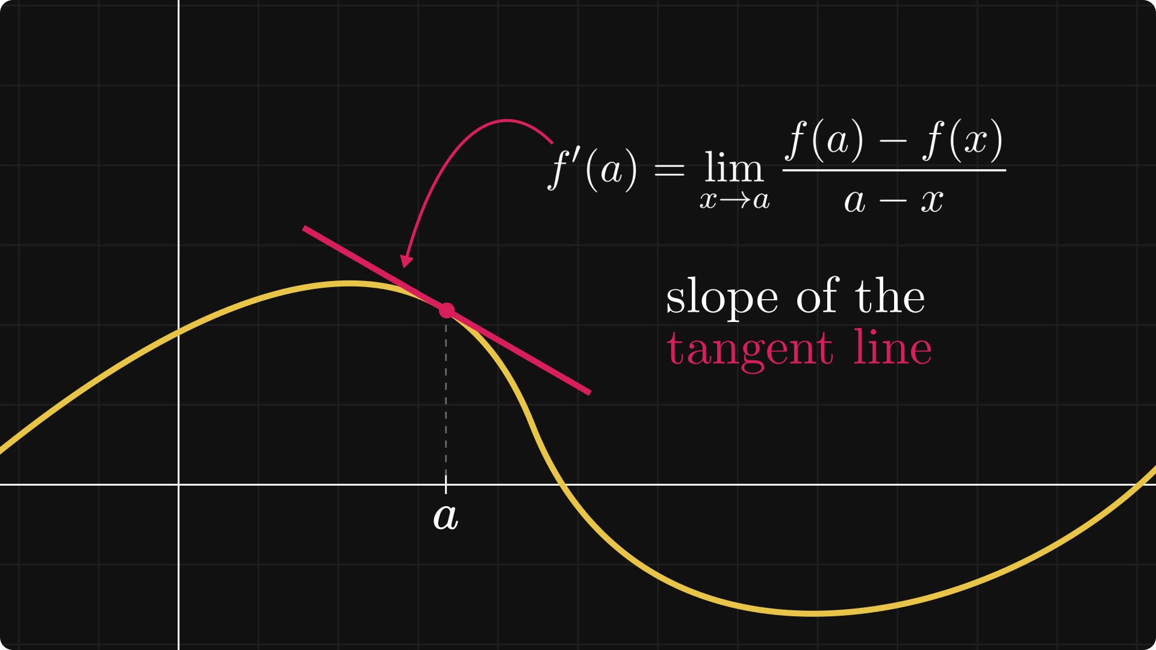
Calculus
>
Pg: 1

Slide 28
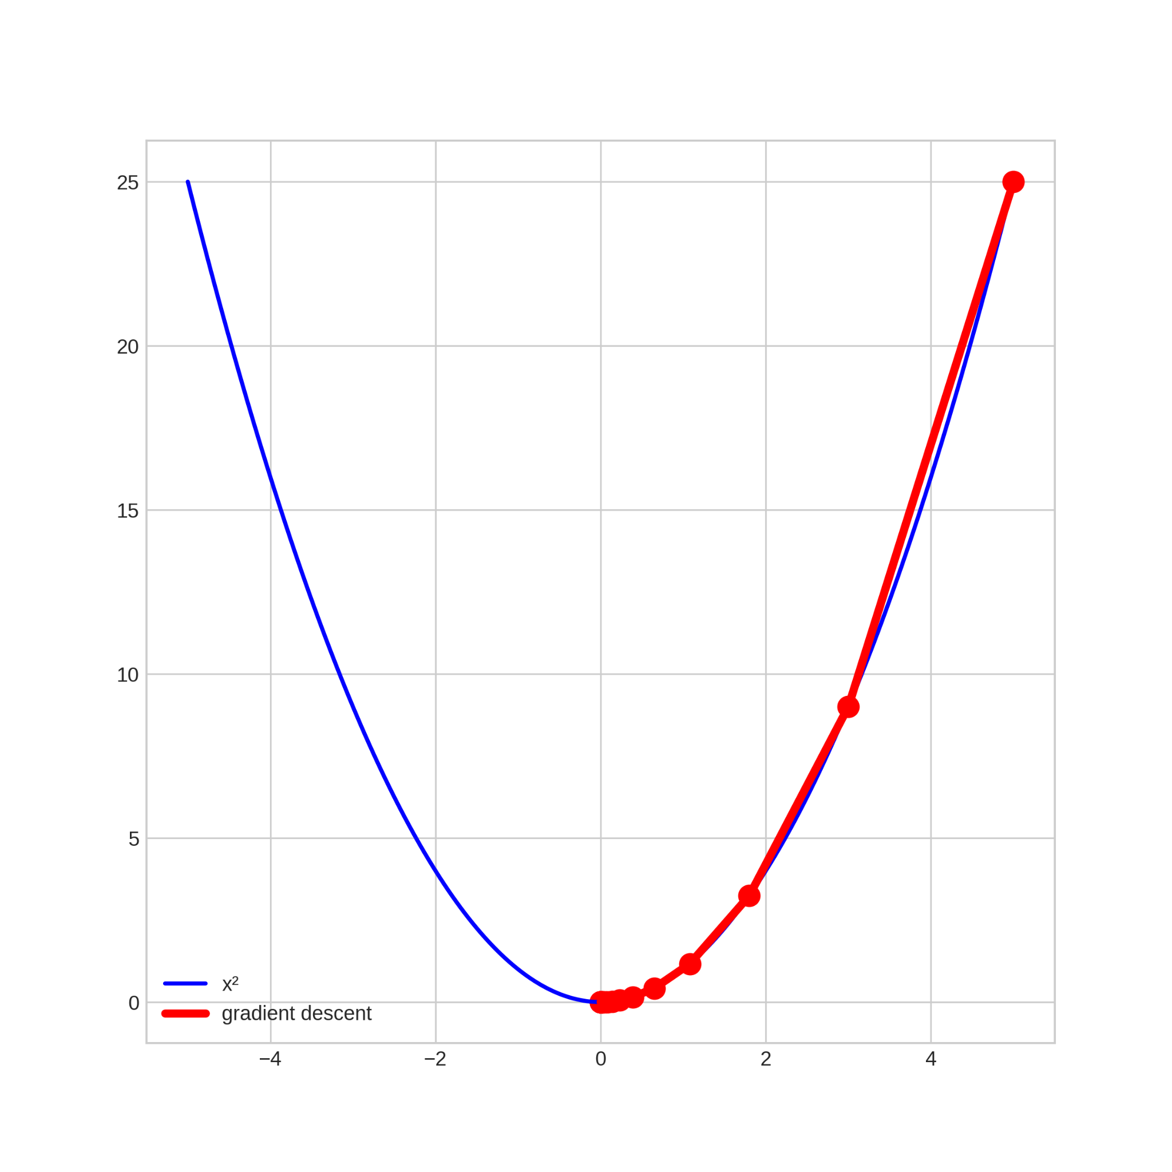
Calculus
>
Pg: 1

Slide 29
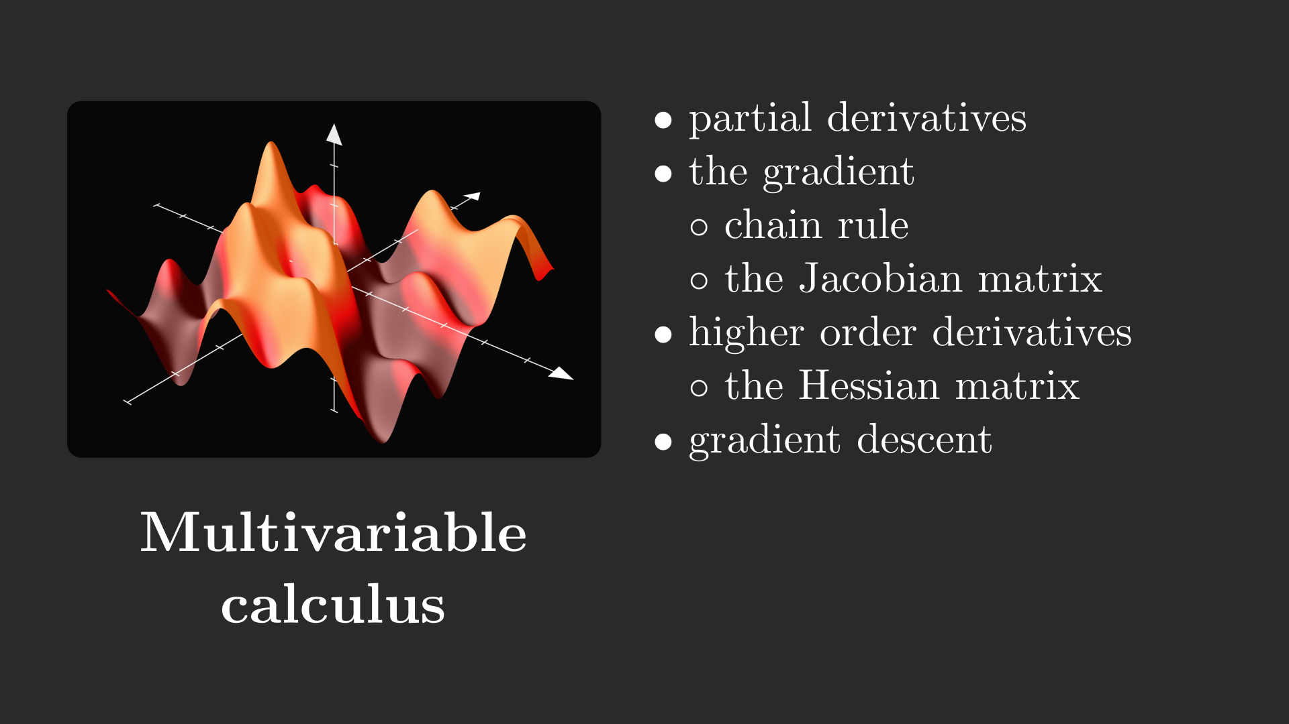
What kind of math do you need?
>
Pg: 1

Slide 30
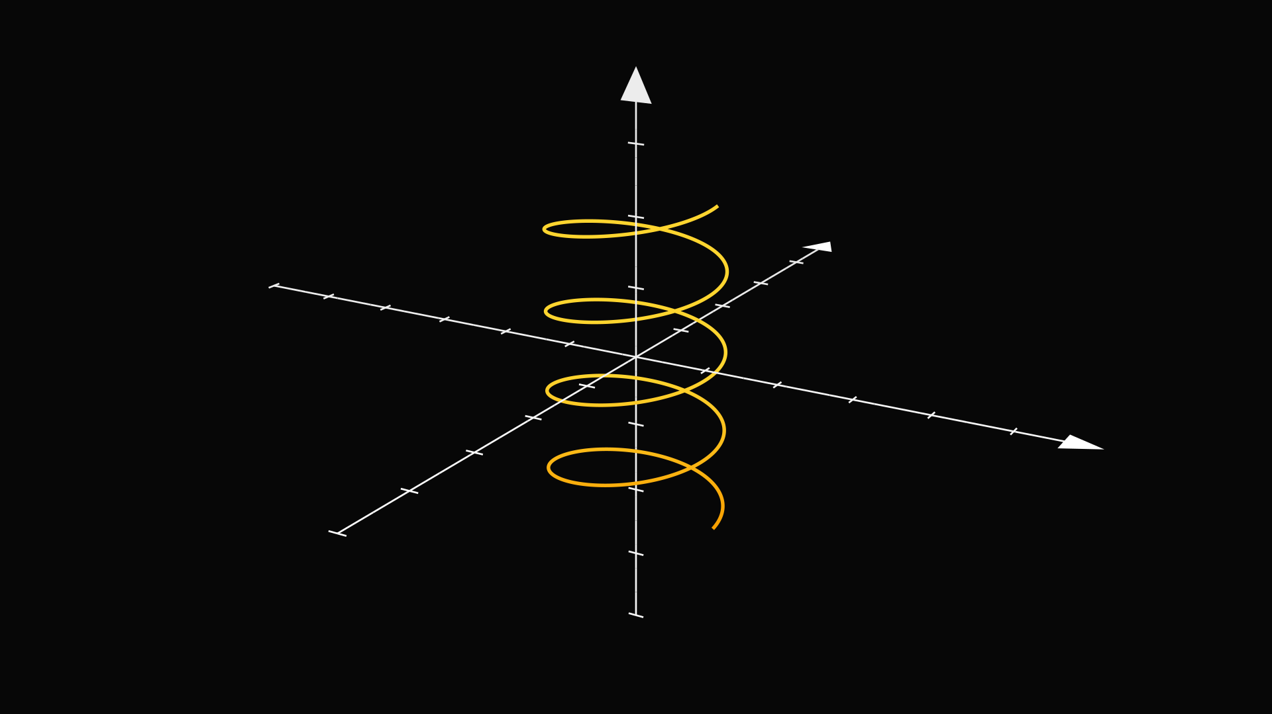
Multivariable calculus
>
Pg: 1

Slide 31
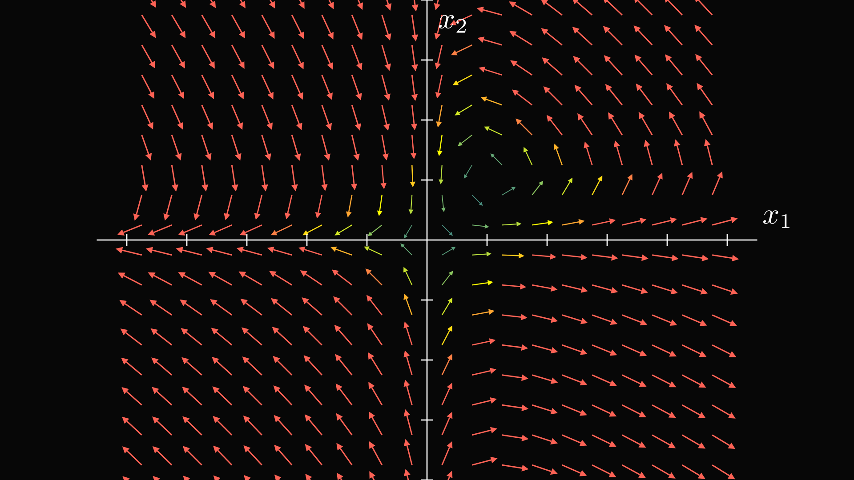
Multivariable calculus
>
Pg: 1

Slide 32
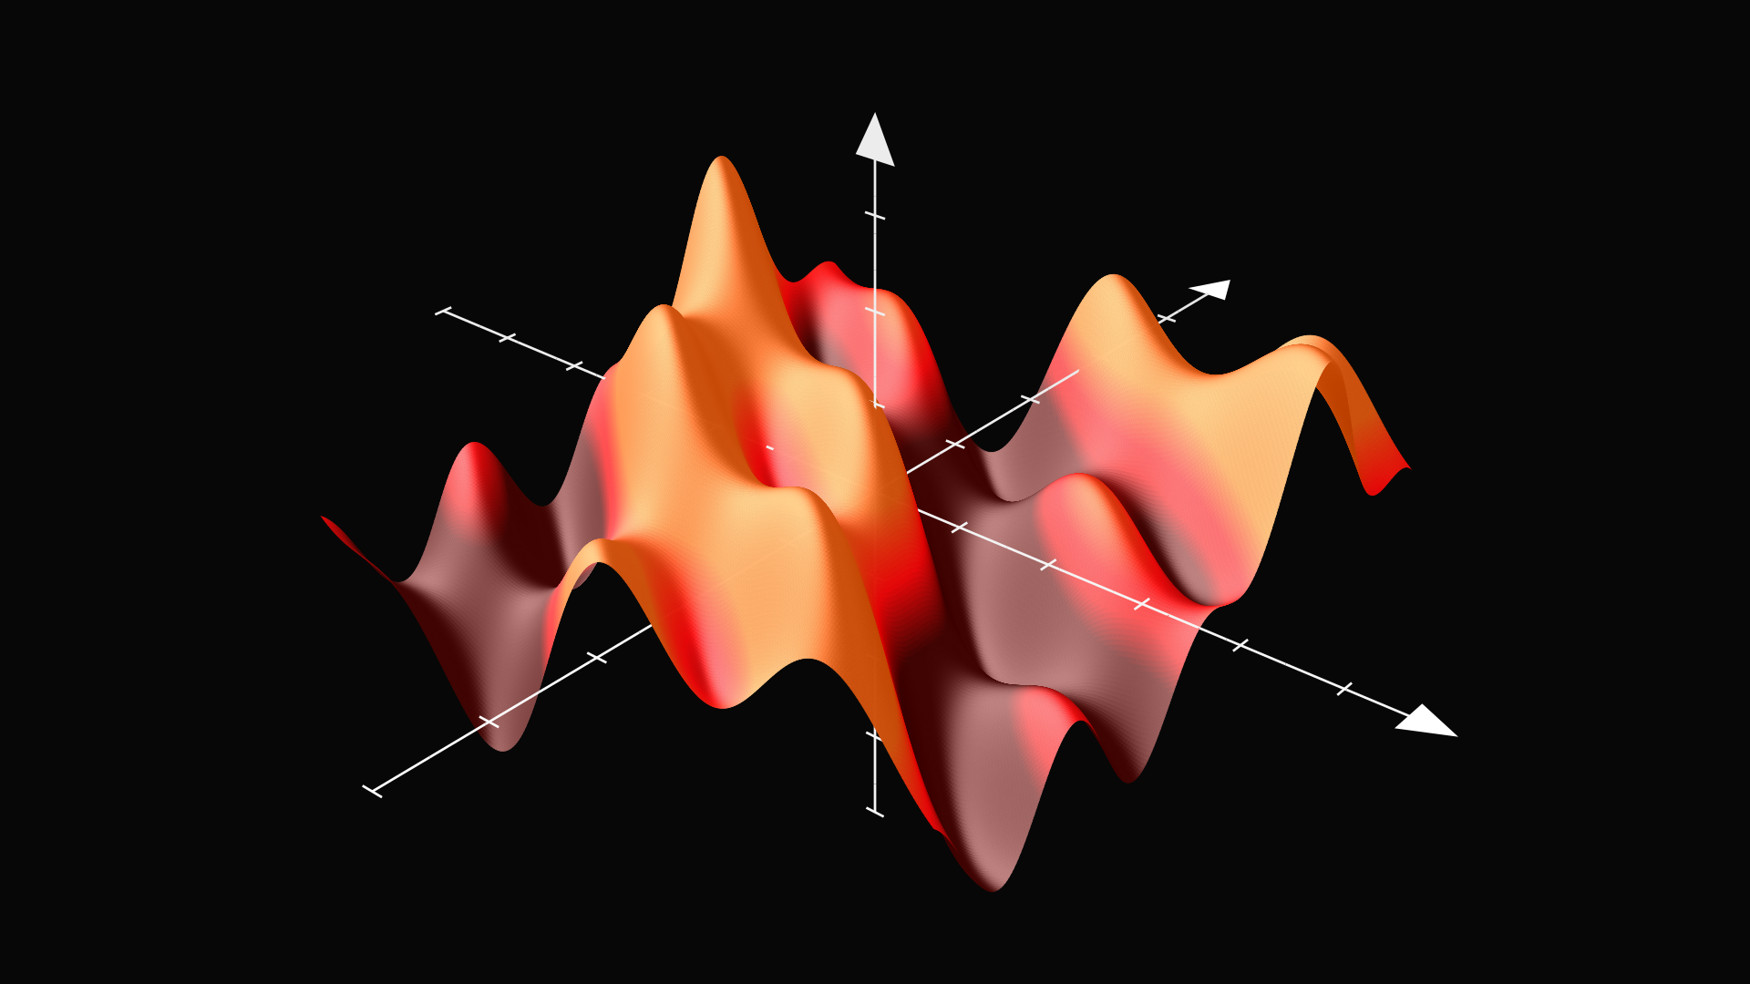
Multivariable calculus
>
Pg: 1

Slide 33
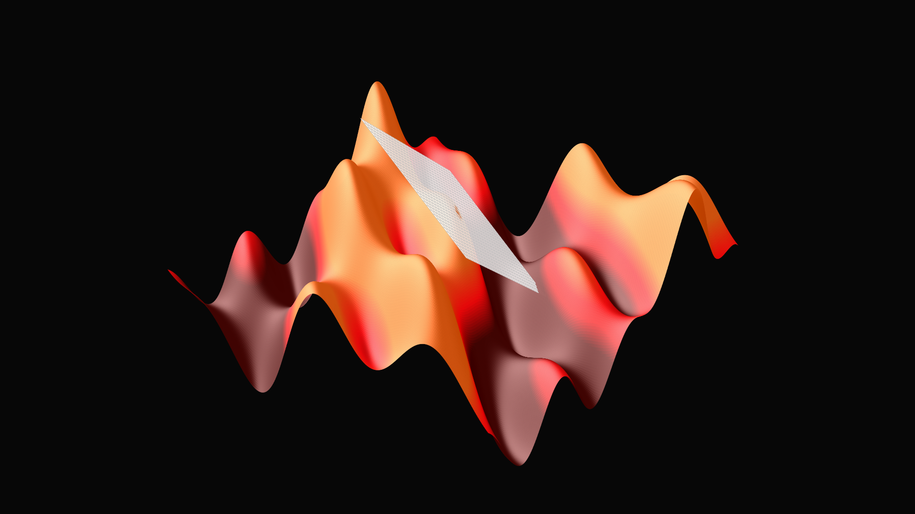
Multivariable calculus
>
Pg: 1

Slide 34
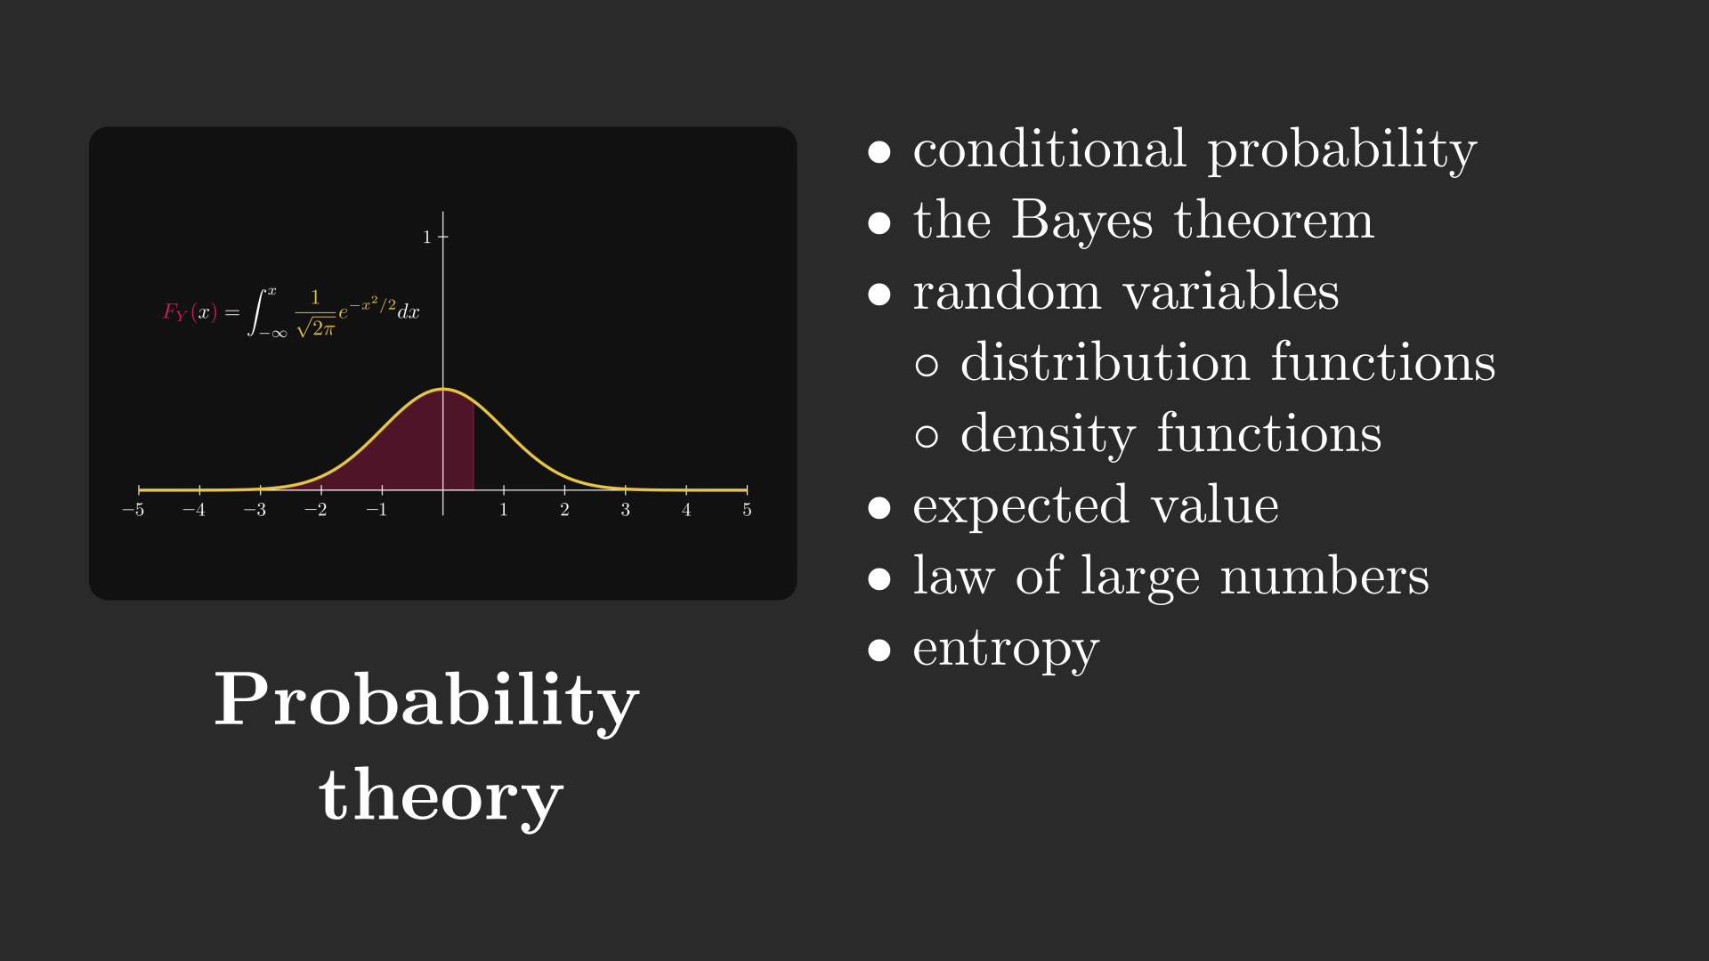
What kind of math do you need?
>
Pg: 1

Slide 35
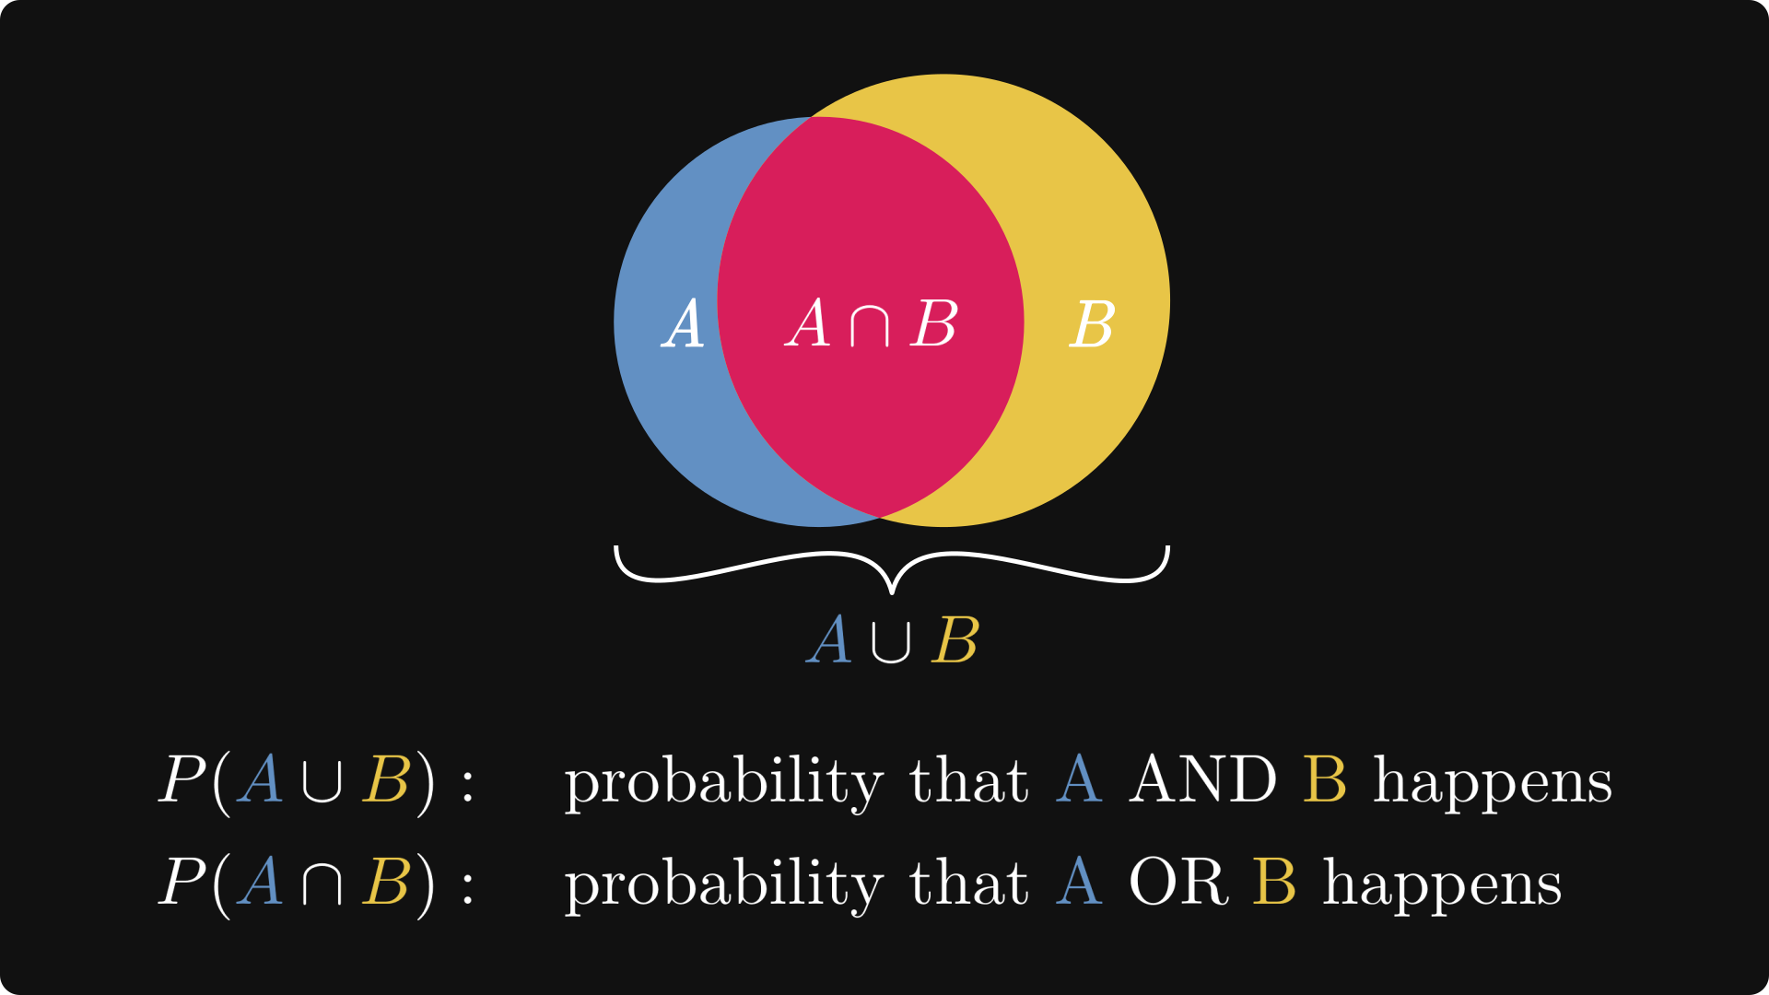
Probability theory
>
Pg: 1

Slide 36
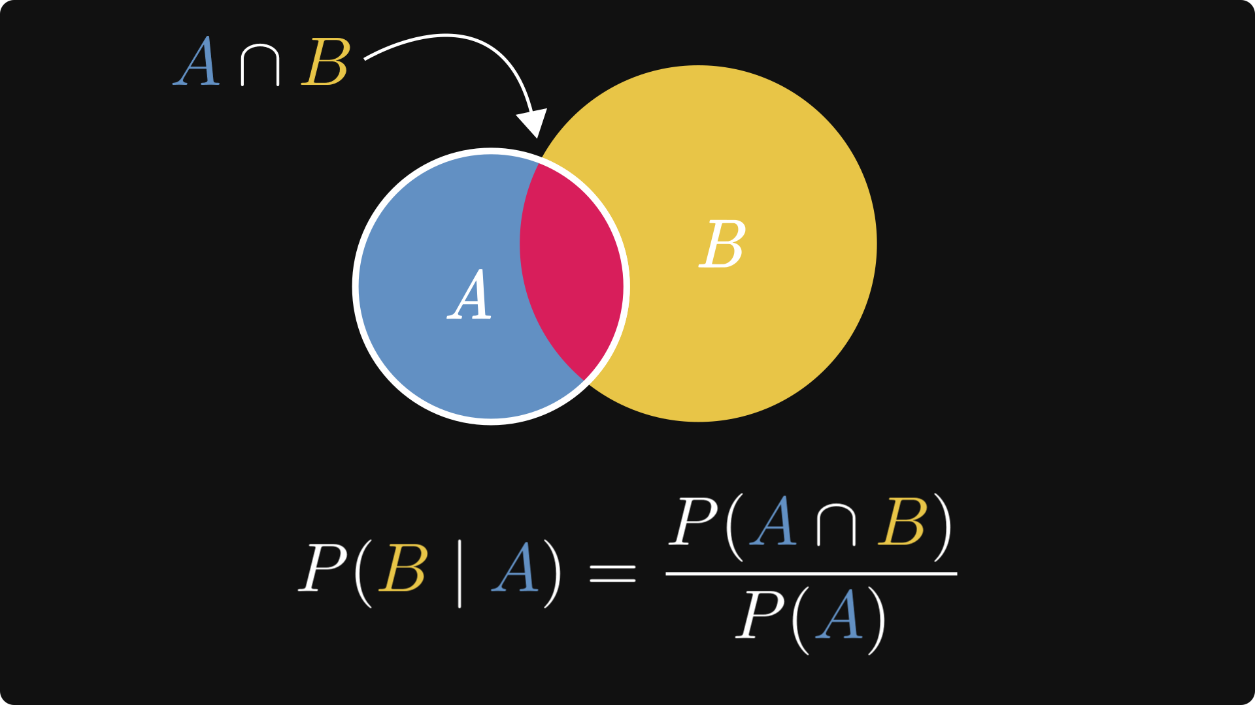
Probability theory
>
Pg: 1

Slide 37
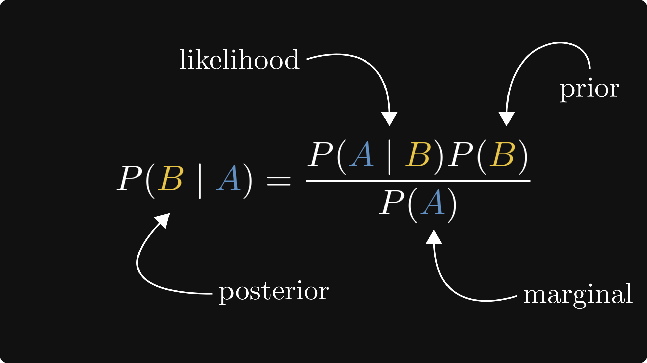
Probability theory
>
Pg: 1

Slide 38
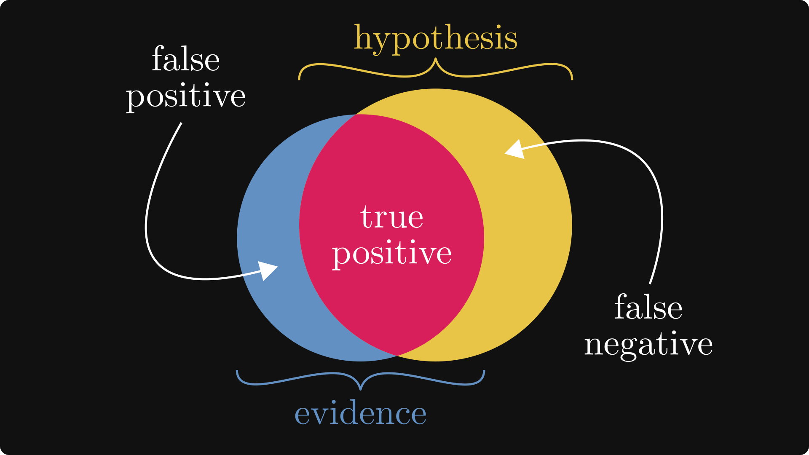
Probability theory
>
Pg: 1

Slide 39
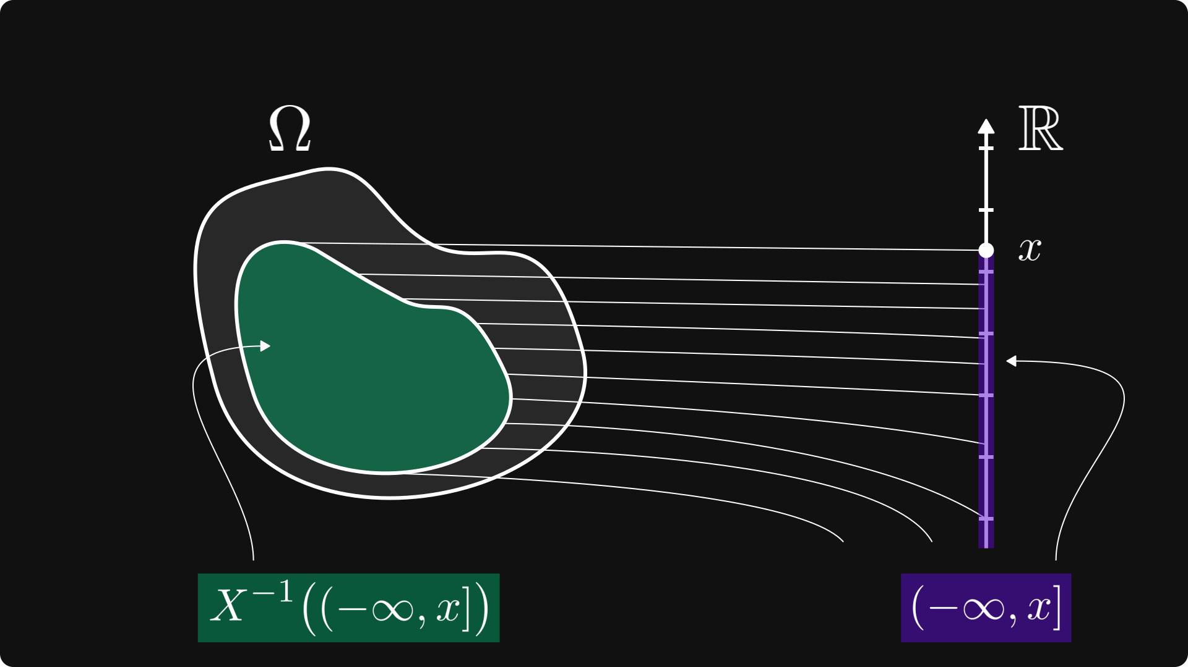
Probability theory
>
Pg: 1

Slide 40
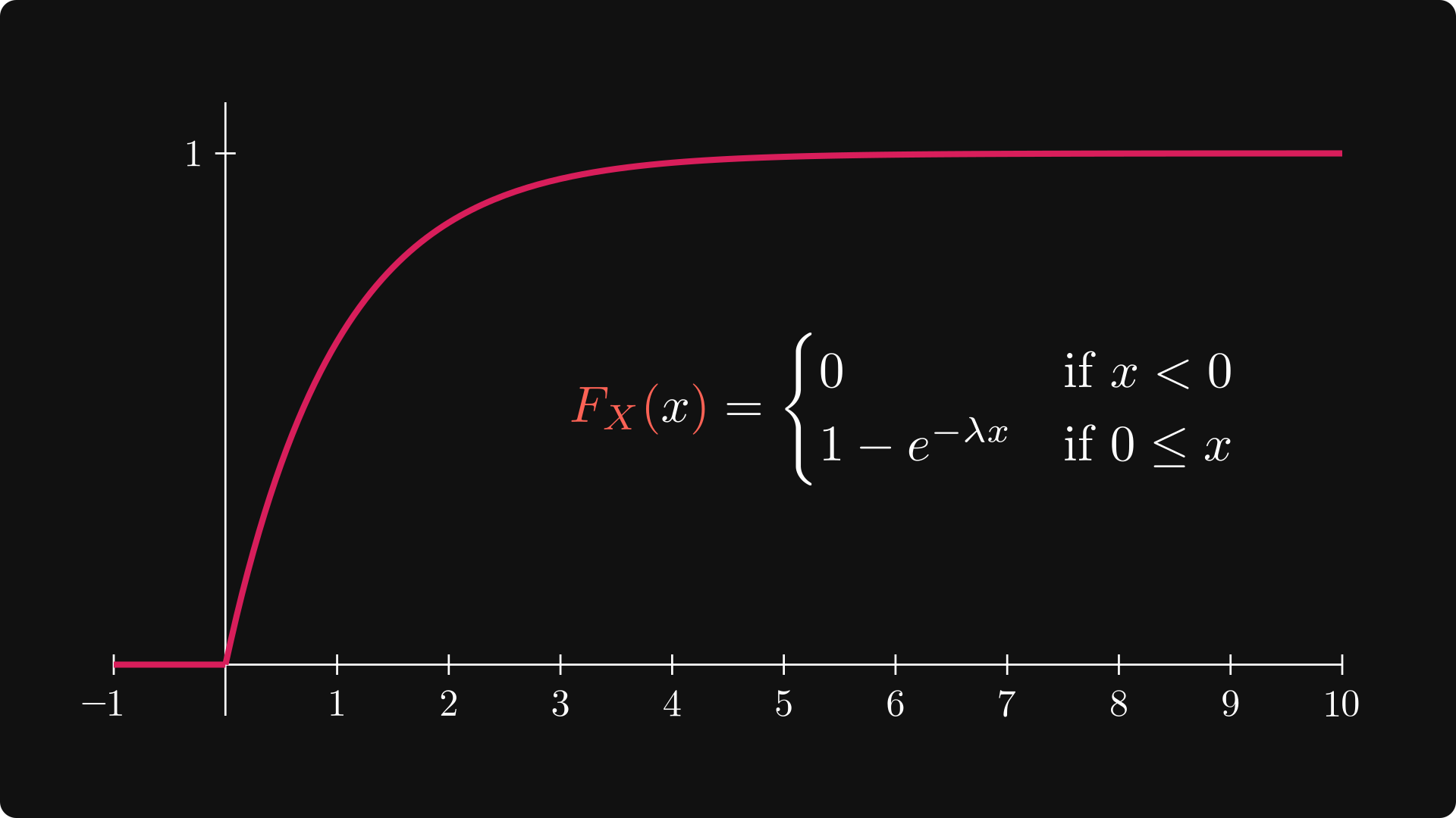
Probability theory
>
Pg: 1

Slide 41
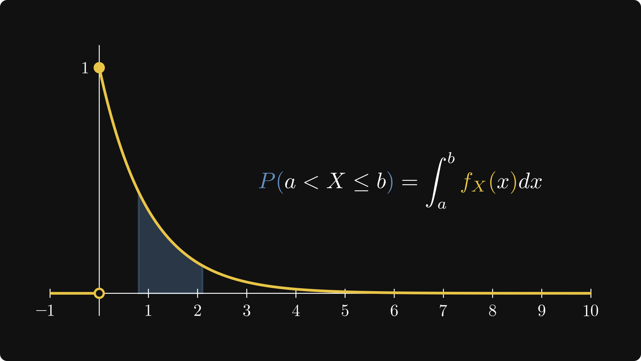
Probability theory
>
Pg: 1

Slide 42
Thank you for
your attention!

